Slide 1
Topics in Data Science
Classification
Naïve Bayes Method
Lecture 11

Slide 2
Classification using Naïve Bayes
Classifiers based on Bayesian methods utilize training data to calculate an observed probability of each outcome based on the evidence provided by feature values. When the classier is later applied to unlabeled data, it uses the observed probabilities to predict the most likely class for the new features. Bayesian classifiers have been used for
Text classification, such as junk e-mail (spam) filtering
Intrusion or anomaly detection in computer networks
Diagnosing medical conditions given a set of observed symptom
Typically, Bayesian classifiers are best applied to problems in which the information from numerous attributes should be considered simultaneously in order to estimate the overall probability of an outcome.
Remark: Naïve Bayes assumes that all of the features in the dataset are equally important and independent. These assumptions are rarely true in most real-world applications, so it is called Naïve method.

Slide 3
Naïve Bayes Classification
Naive Bayes is a Supervised Machine Learning algorithm based on the Bayes Theorem that is used to solve classification problems by following a probabilistic approach. It is based on the idea that the predictor variables in a Machine Learning model are independent of each other. Meaning that the outcome of a model depends on a set of independent variables that have nothing to do with each other.

Slide 4
Why it is called Naïve ?
In real-world problems, predictor variables aren’t always independent of each other, there are always some correlations between them.
Since Naive Bayes considers each predictor variable to be independent of any other variable in the model, it is called ‘Naive’.

Slide 5
Bayes Theorem

Slide 6
Naïve Bayes
Probabilistic classification technique based on Bayes theorem.
Widely used and especially successful at classifying texts
Goal: Estimate the most probable class label for a given record.
Probabilistic formulation of the classification task:
– consider each attribute and class label as random variables
– Given a record with attributes (A1, A2,…,An),
Find the class C that maximizes the conditional probability
P(C| A1, A2,…,An )
Example: Should we play golf based on Temperature and Outlook?
P(Play=yes | Outlook=rainy, Temperature=cool)
P(Play=no | Outlook=rainy, Temperature=cool)
Question: How to estimate these probabilities given training data?

Slide 7
Bayes Classifier
A probabilistic framework for solving classification problems
Conditional Probability:
Bayes theorem:

Slide 8
Example of Bayes Theorem
Given:
A doctor knows that meningitis causes stiff neck 50% of the time
Prior probability of any patient having meningitis is 1/50,000
Prior probability of any patient having stiff neck is 1/20
If a patient has stiff neck, what’s the probability he/she has meningitis?

Slide 9
Bayes’ Theorem

Slide 10
Bayes’ Theorem

Slide 11
Bayes’ Theorem

Slide 12
Bayes’ Theorem

Slide 13
Strength &Weakness
Strength
Simple, fast, and very effective
Does well with noisy and missing data
Requires relatively few examples for training, but also works well with very large numbers of examples
Easy to obtain the estimated probability for a prediction
Weakness
Relies on an often-faulty assumption of equally important and independent features
Not ideal for datasets with many numeric features
Estimated probabilities are less reliable than the predicted classes

Slide 14
Prior and Posterior Probability

Slide 15
Applying Bayes theorem in Classification

Slide 16
Calculating Prior Probability
Outlook | Temp | Humidity | Windy | Play
Sunny | Hot | High | False | No
Sunny | Hot | High | True | No
Overcast | Hot | High | False | Yes
Rainy | Mild | High | False | Yes
Rainy | Cool | Normal | False | Yes
Rainy | Cool | Normal | True | No
Overcast | Cool | Normal | True | Yes
Sunny | Mild | High | False | No
Sunny | Cool | Normal | False | Yes
Rainy | Mild | Normal | False | Yes
Sunny | Mild | Normal | True | Yes
Overcast | Mild | High | True | Yes
Overcast | Hot | Normal | False | Yes
Rainy | Mild | High | True | No
The prior probability P(Cj) for each
class is estimated by
1. counting the records in the training
set that are labeled with class Cj
2. dividing the count by the overall
number of records
Example:
P(Play=Yes)=9/14
P(Play=No)=5/14
Since there are two possible outcome
Binary classification problem

Slide 17
Calculating the conditional probability
Naïve Bayes assumes that all attributes are statistically independent.
knowing the value of one attribute says nothing about the value of another
this independence assumption is quite strong and may never be correct but works in general
The independence assumption allows the joint probability P(A | C) to be reformulated as the product of the individual probabilities P(Ai| Cj):
P(A1, A2, …, An | Cj) = P(A1| Cj) x P(A2| Cj) x … x P(An| Cj)
P(Outlook=rainy, Temperature=cool | Play=yes)
= P(Outlook=rainy | Play=yes) x P(Temperature=cool | Play=yes)

Slide 19
Predicting the outcome

Slide 20
Prediction

Slide 21
Graphical Presentation

Slide 22
R code
>data=read.table("C:\\Users\\aryal\\Desktop\\Golf.txt",header=T,stringsAsFactors = TRUE)
> data
> library(e1071)
> nb_model <- naiveBayes(Play~., data=data)
> nb_model
#########################################
>library(naivebayes)
>library(dplyr)
>library(ggplot2)
>library(psych)
> modelnb <- naive_bayes(Play~., data=data,laplace=1)
> modelnb
> par(mfrow=c(2,2))
> plot(modelnb)

Slide 23
Example –Iris Data
library(e1071)
library(caTools)
data_naive<-iris
summary(data_naive)
##################
split=sample.split(data_naive$Species,SplitRatio = 0.7)
train_data=subset(data_naive,split==T)
test_data=subset(data_naive,split==F)
###########
model<-naiveBayes(Species~.,data=train_data)
print(model)
#############
pred<-predict(model,test_data)
table(pred,test_data$Species)
###################
library(caret)
cm = confusionMatrix(test_data$Species, pred)
cm

Slide 24
Example-Iris Data
library(e1071)
library(caTools)
head(iris)
x = iris[,-5]
y = iris$Species
model = train(x,y,'nb',trControl=trainControl(method='cv',number=10))
predict(model$finalModel,x)
table(predict(model$finalModel,x)$class,y)

Slide 25
Example-Iris Data
library(e1071)
library(caret)
data(iris)
set.seed(123)
indexes = createDataPartition(iris$Species, p = .9, list = F)
train = iris[indexes, ]
test = iris[-indexes, ]
nb = naiveBayes(Species~., data = train)
print(nb)
pred = predict(nb, test, type="class")
cm = confusionMatrix(test$Species, pred)
print(cm)

Slide 26
Naïve Bayes –Using R
Example: A researcher is interested in how variables, such as GRE (Graduate Record Exam scores), GPA (grade point average) and prestige of the undergraduate institution, effect admission into graduate school. The response variable, admit/don’t admit, is a binary variable. The data are provided at https://stats.idre.ucla.edu/stat/data/binary.csv
library(naivebayes)
library(dplyr)
library(ggplot2)
library(psych)
data <- read.csv("https://stats.idre.ucla.edu/stat/data/binary.csv")
attach(data)
xtabs(~admit+rank,data=data)
admit=as.factor(admit)
rank=as.factor(rank)
data=data.frame(admit,gre,gpa,rank)

Slide 27
Visualization
Correlation Matrix
pairs.panels(data[-1])
Boxplot
ggplot(aes(x=admit, y=gre, fill=admit))+geom_boxplot()+ggtitle("Boxplot")
Density plot
ggplot(aes(x=gre, fill=admit))+geom_density(alpha=0.8, col="black")

Slide 28
Data Partition, model building and prediction
> set.seed(123)
> ind=sample(2,nrow(data),replace=T, prob=c(0.8,0.2))
> train=data[ind==1,]
> test=data[ind==2,]
Model
> model=naive_bayes(admit~., data=train)
> model
> par(mfrow=c(1,3))
> plot(model)
Prediction
> pred=predict(model, train, type='p’)
> head(cbind(pred,train))

Slide 29
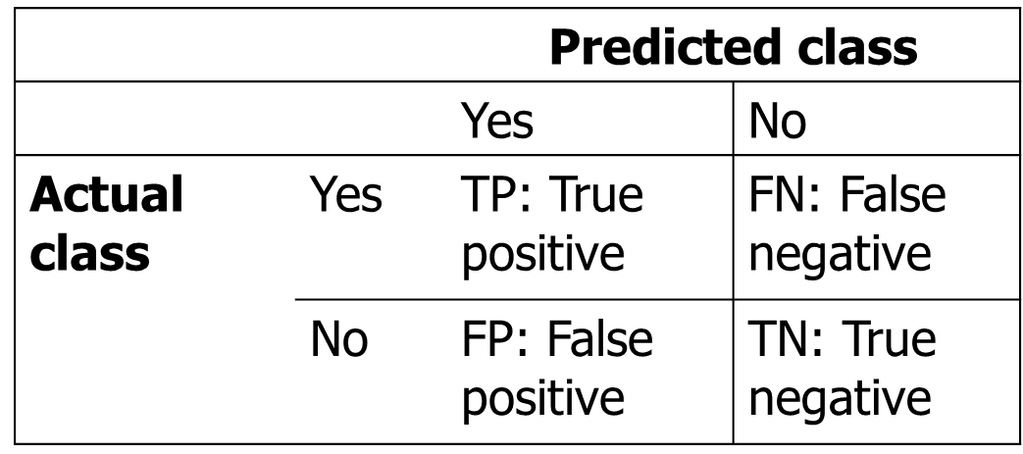
Confusion Matrix
A confusion matrix is a table that is often used to describe the performance of a classification model (or "classifier") on a set of test data for which the true values are known.
Goal: minimize FP+FN
TPR (True Positive Rate): TP / (TP + FN)
FPR (False Positive Rate): FP / (TN + FP)

Slide 30
Confusion Matrix
> pred=predict(model, train)
> tab1=table(pred, train$admit)
pred 0 1
0 184 70
1 32 39
Misclassification
>1-sum(diag(tab1))/sum(tab1)
######################################################
> pred1=predict(model, test)
> tab2=table(pred1, test$admit)
> tab2
pred1 0 1
0 49 14
1 8 4
Misclassification
> misclassification<- 1-sum(diag(tab2))/sum(tab2)
# Correct_CalssifiCat1ion
> 1-misclassification

Slide 31
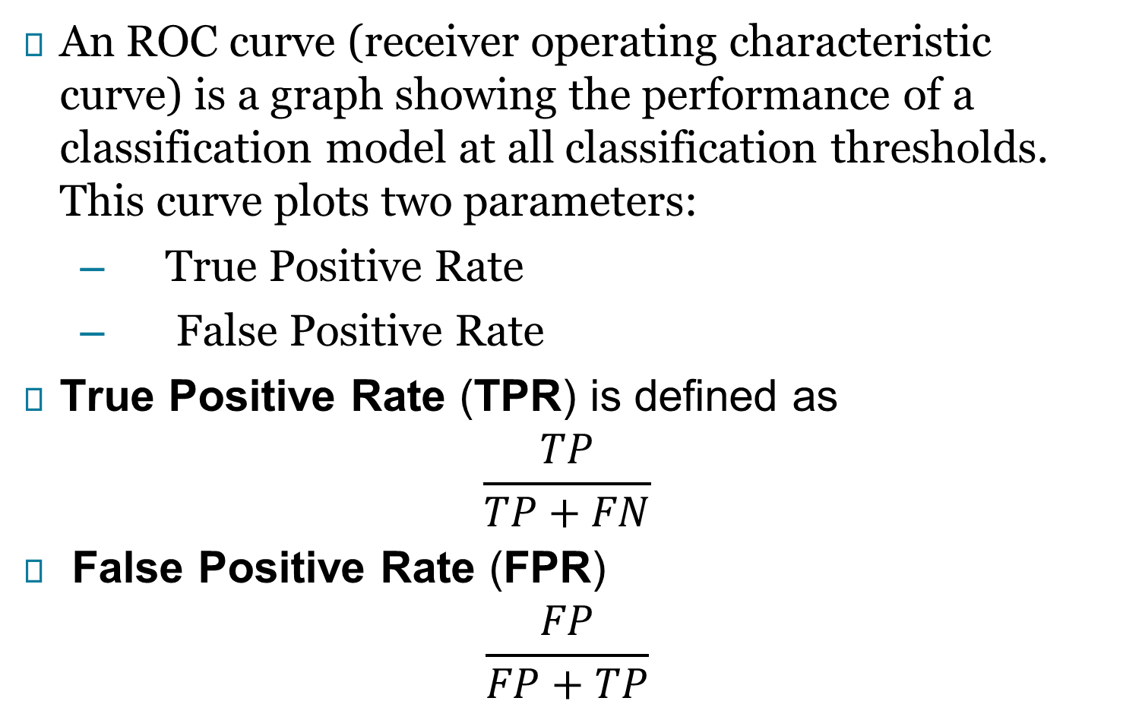
ROC Curve and AUC
An ROC curve (receiver operating characteristic curve) is a graph showing the performance of a classification model at all classification thresholds. This curve plots two parameters:
True Positive Rate
False Positive Rate
True Positive Rate (TPR) is defined as
$$\frac{TP}{TP+FN}$$
False Positive Rate (FPR)
$$\frac{FP}{FP+TP}$$

Slide 32
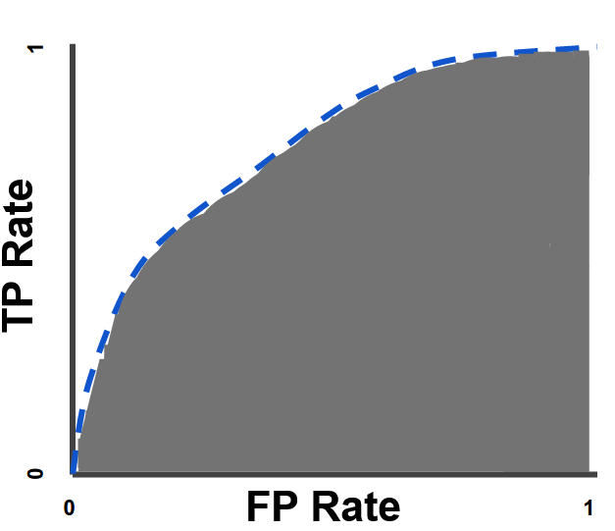
ROC curve and AUC
An ROC curve plots TPR vs. FPR at different classification thresholds.
AUC stands for "Area under the ROC Curve." That is, AUC measures the entire two-dimensional area underneath the entire ROC curve (think integral calculus) from (0,0) to (1,1).

Slide 33
ROC curve and AUC -Example
library(naivebayes)
library(dplyr)
library(ggplot2)
library(psych)
library(ROCR)
library(pROC)
data <- read.csv("https://stats.idre.ucla.edu/stat/data/binary.csv")
attach(data)
set.seed(123)
ind=sample(2,nrow(data),replace=T, prob=c(0.8,0.2))
train=data[ind==1,]
test=data[ind==2,]
#### ROC Curve#####
####### For Training Data #####
model<-naiveBayes(admit~., data=train, laplace=1)
model
pred_nb<-predict(model, train, type= "raw")[, 2]
pred_roc_nb<-prediction(pred_nb, train$admit)
pred_roc<-performance(pred_roc_nb, "tpr", "fpr")
plot(pred_roc, colorize = TRUE, main="ROC Curve using Naive Bayes for Training Data")
#### Area Under the Curve#####
library(pROC)
auc_nb<-performance(pred_roc_nb, "auc")
auc<- unlist(slot(auc_nb, "y.values"))
auc

Slide 34
Using Bayes Theorem for Classification
Consider each attribute and class label as random variables
Given a record with attributes (X₁, X₂,…, X_{d})
Goal is to predict class Y
Specifically, we want to find the value of Y that maximizes P(Y| X₁, X₂,…, X_{d} )
Can we estimate P(Y| X₁, X₂,…, X_{d} ) directly from data?

Slide 35
Example: Catching tax evasion
Given a Test Record:
Can we estimate
P(Evade = Yes | X) and P(Evade = No | X)?
In the following we will replace
Evade = Yes by Yes, and
Evade = No by No

Slide 36
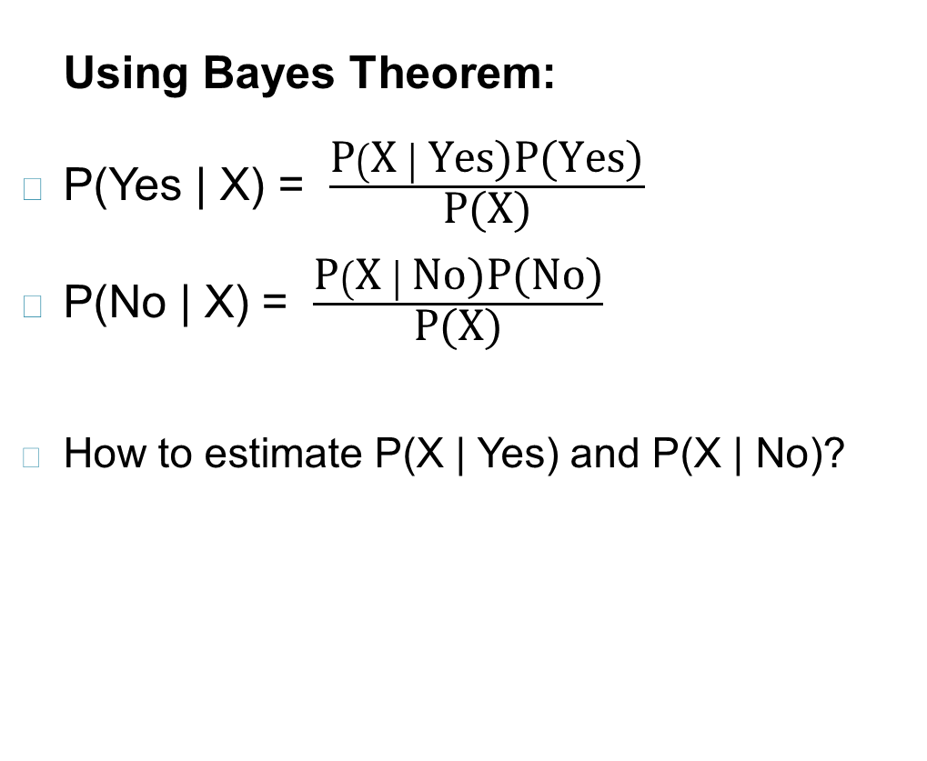
Example Data
Given a Test Record:

Slide 37
Naïve Bayes Classifier
Assume independence among attributes X_{i} when class is given:
P(X₁, X₂, …, X_{d} |Y_{j}) = P(X₁| Y_{j}) P(X₂| Y_{j})… P(X_{d}| Y_{j})
Now we can estimate P(X_{i}| Y_{j}) for all X_{i} and Y_{j} combinations from the training data
New point is classified to Y_{j} if P(Y_{j}) Π P(X_{i}| Y_{j}) is maximal.

Slide 38
Naïve Bayes on Example Data
Given a Test Record:
P(X | Yes) =
P(Refund = No | Yes) x
P(Divorced | Yes) x
P(Income = 120K | Yes)
P(X | No) =
P(Refund = No | No) x
P(Divorced | No) x
P(Income = 120K | No)

Slide 39
Estimate Probabilities from Data
Class: P(Y) = N_{c}/N
e.g., P(No) = 7/10, P(Yes) = 3/10
For categorical attributes: P(X_{i} | Y_{k}) = |X_{ik}|/ N_{c}
where |X_{ik}| is number of instances having attribute value X_{i} and belonging to class Y_{k}
Examples:
P(Status=Married|No) = 4/7 P(Refund=Yes|Yes)=0

Slide 40
Estimate Probabilities from Continuous Data
For continuous attributes:
Discretization: Partition the range into bins:
Replace continuous value with bin value
Attribute changed from continuous to ordinal
Temp= 37°C -- “Hot”
• Temp= 21°C -- “Mild”
Probability density estimation:
Assume attribute follows a normal distribution
Use data to estimate parameters of distribution (e.g., mean and standard deviation)
Once probability distribution is known, use it to estimate the conditional probability P(X_{i}|Y)

Slide 41
Normal Distribution

Slide 42
Statistics for weather data

Slide 43
Classifying a new day

Slide 44
Missing Values

Slide 45
Estimate Probabilities –Tax data
Normal distribution:
One for each (X_{i},Y_{i}) pair
For (Income, Class=No):
If Class=No
sample mean = 110
sample variance = 2975

Slide 46
Example
Given a Test Record:
Naïve Bayes Classifier:
P(Refund = Yes | No) = 3/7
P(Refund = No | No) = 4/7
P(Refund = Yes | Yes) = 0
P(Refund = No | Yes) = 1
P(Marital Status = Single | No) = 2/7
P(Marital Status = Divorced | No) = 1/7
P(Marital Status = Married | No) = 4/7
P(Marital Status = Single | Yes) = 2/3
P(Marital Status = Divorced | Yes) = 1/3
P(Marital Status = Married | Yes) = 0
For Taxable Income:
If class = No: sample mean = 110
sample variance = 2975
If class = Yes: sample mean = 90
sample variance = 25
P(X | No) = P(Refund=No | No) × P(Divorced | No) × P(Income=120K | No) = 4/7 × 1/7 × 0.0072 = 0.0006
P(X | Yes) = P(Refund=No | Yes) × P(Divorced | Yes) × P(Income=120K | Yes) = 1 × 1/3 × 1.2 × 10⁻⁹ = 4 × 10⁻¹⁰
Since P(X|No)P(No) > P(X|Yes)P(Yes)
Therefore P(No|X) > P(Yes|X) => Class = No

Slide 47
Example of Naïve Bayes Classifier
Given a Test Record:
Naïve Bayes Classifier:
P(Refund = Yes | No) = 3/7
P(Refund = No | No) = 4/7
P(Refund = Yes | Yes) = 0
P(Refund = No | Yes) = 1
P(Marital Status = Single | No) = 2/7
P(Marital Status = Divorced | No) = 1/7
P(Marital Status = Married | No) = 4/7
P(Marital Status = Single | Yes) = 2/3
P(Marital Status = Divorced | Yes) = 1/3
P(Marital Status = Married | Yes) = 0
For Taxable Income:
If class = No: sample mean = 110
sample variance = 2975
If class = Yes: sample mean = 90
sample variance = 25
P(Yes) = 3/10
P(No) = 7/10
P(Yes | Divorced) = 1/3 x 3/10 / P(Divorced)
P(No | Divorced) = 1/7 x 7/10 / P(Divorced)
P(Yes | Refund = No, Divorced) = 1 x 1/3 x 3/10 / P(Divorced, Refund = No)
P(No | Refund = No, Divorced) = 4/7 x 1/7 x 7/10 / P(Divorced, Refund = No)

Slide 48
Issues with Naïve Bayes Classifier
Naïve Bayes Classifier:
P(Refund = Yes | No) = 3/7
P(Refund = No | No) = 4/7
P(Refund = Yes | Yes) = 0
P(Refund = No | Yes) = 1
P(Marital Status = Single | No) = 2/7
P(Marital Status = Divorced | No) = 1/7
P(Marital Status = Married | No) = 4/7
P(Marital Status = Single | Yes) = 2/3
P(Marital Status = Divorced | Yes) = 1/3
P(Marital Status = Married | Yes) = 0
For Taxable Income:
If class = No: sample mean = 110
sample variance = 2975
If class = Yes: sample mean = 90
sample variance = 25
P(Yes) = 3/10
P(No) = 7/10
P(Yes | Married) = 0 x 3/10 / P(Married)
P(No | Married) = 4/7 x 7/10 / P(Married)

Slide 49
Issues with Naïve Bayes Classifier
Consider the table with Tid = 7 deleted
Naïve Bayes Classifier:
P(Refund = Yes | No) = 2/6
P(Refund = No | No) = 4/6
P(Refund = Yes | Yes) = 0
P(Refund = No | Yes) = 1
P(Marital Status = Single | No) = 2/6
P(Marital Status = Divorced | No) = 0
P(Marital Status = Married | No) = 4/6
P(Marital Status = Single | Yes) = 2/3
P(Marital Status = Divorced | Yes) = 1/3
P(Marital Status = Married | Yes) = 0/3
For Taxable Income:
If class = No: sample mean = 91
sample variance = 685
If class = No: sample mean = 90
sample variance = 25
Given X = (Refund = Yes, Divorced, 120K)
P(X | No) = 2/6 X 0 X 0.0083 = 0
P(X | Yes) = 0 X 1/3 X 1.2 X 10⁻⁹ = 0
Naïve Bayes will not be able to classify X as Yes or No!

Slide 50
The zero- frequency problem
One of the disadvantages of Naïve-Bayes is that if you have no occurrences of a class label and a certain attribute value together then the frequency-based probability estimate will be zero. And this will get a zero when all the probabilities are multiplied.
An approach to overcome this ‘zero-frequency problem’ in a Bayesian environment is to add one to the count for every attribute value-class combination when an attribute value doesn’t occur with every class value.

Slide 51
The zero- frequency problem (Example)
 | Spam=Yes | Spam=No
Country=US | 10 | 5
Country=UK | 0 | 0
 | Spam=Yes | Spam=No
Country=US | 10 | 5
Country=UK | 0 | 0
𝑃(Country=𝑈𝑆|Spam=𝑦𝑒𝑠)=10/10=1
𝑃(Country=𝑈K|Spam=𝑦𝑒𝑠)=0/10=0
Then you should add one to every value in this table when you’re using it to calculate probabilities:
 | Spam=Yes | Spam=No
Country =US | 11 | 6
Country=UK | 1 | 1

Slide 52
Issues with Naïve Bayes Classifier
If one of the conditional probabilities is zero, then the entire expression becomes zero
Need to use other estimates of conditional probabilities than simple fractions
Probability estimation:
c: number of classes
p: prior probability of the class
m: parameter N_{c}: number of instances in the class
N_{ic}: number of instances having attribute value A_{i} in class c

Slide 53
Naïve Bayes (Summary)
Robust to isolated noise points
Handle missing values by ignoring the instance during probability estimate calculations
Robust to irrelevant attributes
Independence assumption may not hold for some attributes
Use other techniques such as Bayesian Belief Networks (BBN)

Slide 54
References
Introduction to Data Mining
by Pang-Ning Tan, Michael Steinbach,
Anuj Karpatne and Vipin Kumar
Machine learning with R
- Brett Lantz

Slide 55
Thank you

